Slide 1


RESEARCH
PRESENTATION
Glioma mutation detection
and
Classification
Hazem Mahmoud 221002111
Hajar Abdelhalim 221000755
Mallak Ahmed 221000746
Mohamed Bakry 221000360
Christina Lamey 221001505
Ziad ElShazly 221001682
Raheeq Dardir 211001075

Slide 2




Introduction
Glioma Brain Tumor
Glioma is a type of brain tumor that arises from glial cells, which are the supportive cells in the central nervous system (CNS). Glial cells provide structure, protection, and support to neurons. Gliomas can occur in the brain or spinal cord and are among the most common types of brain tumors in adults and children.

Slide 3

Types of Gliomas
Astrocytomas
Oligodendrogliomas
Ependymomas
Glioblastoma

Slide 4
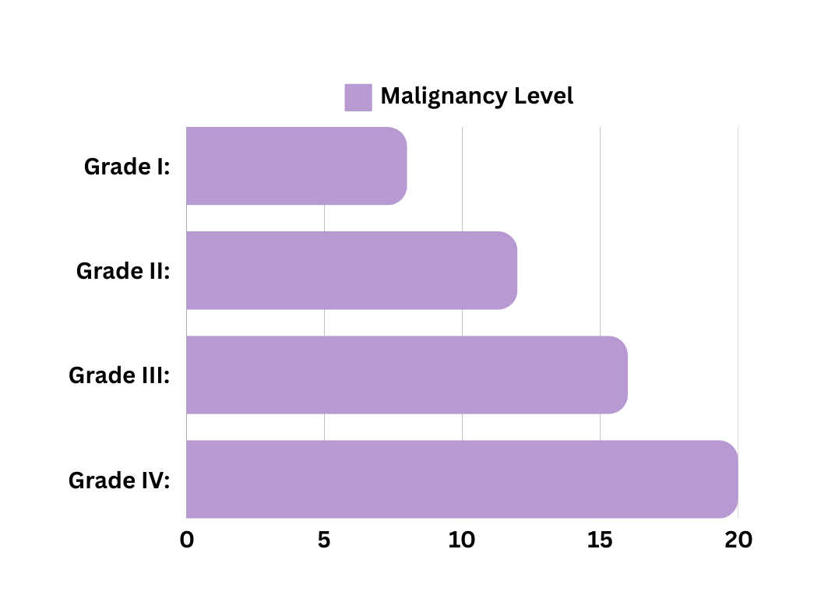
Grades of Glioma
Grade I (Low-Grade): Slow-growing, often well-defined tumors with a good prognosis if treated early.
Grade II (Low-Grade Diffuse): Infiltrative tumors that may transform into higher-grade gliomas over time.
Grade III (Anaplastic): Malignant tumors that grow more rapidly and have a higher potential for recurrence.
Grade IV (Glioblastoma): Highly aggressive and lethal tumors, characterized by rapid growth, and extensive infiltration into surrounding brain tissue, leading to a poor prognosis.

Slide 5

Paper Objective
Impact of Variable RNA-Sequencing Depth on Gene Expression Signatures and Target Compound Robustness: Case Study Examining Brain Tumor (Glioma) Disease Progression
  Purpose: Investigate how reduced sequencing depth impacts differential gene expression detection and downstream connectivity mapping.

Slide 6
Project Hypothesis
The integration of differential gene expression analysis (via DESeq2), functional pathway scoring (via GSVA), and Gene Ontology enrichment can accurately classify glioma subtypes and predict key biological mechanisms associated with glioma progression. Additionally, incorporating these computational analyses into an AI model can improve the precision of glioma subtype diagnosis

Slide 7
Methodology
GO Enrichment analysis
vs
KEGG pathways
Using a machine learning indication model by analyzing the GSVA score
to indicate patient’s subtype of Glioma
Dataset 274 samples
850 GB
Decided to download A sample from each
(Type-Subtype)
Counting tables
(Applied DeSeq2 Tool)
For the visualization:
Volcano Plot
Bar Chart

Slide 8
Methodology
GO (Gene Ontology)
Enrichment Analysis
KEGG Pathways
GSVA Method
Used to identify whether specific biological processes, cellular components, or molecular functions are significantly overrepresented in a set of genes (e.g., differentially expressed genes).
Key Difference:
  GO terms describe what functions or locations genes are associated with.
  KEGG pathways describe how genes interact in biological systems to perform these functions
GSVA is a method used in bioinformatics to calculate how active a group of genes (a gene set or pathway) is in a sample. Instead of analyzing individual genes, GSVA focuses on groups of genes that work together to perform a biological function (e.g., a signaling pathway).
Focuses on general biological functions and annotations
Most important factor for determining the kind of sybtype of Glioma in the patient.

Slide 9
Results
Built a Machine learning model to indicate the subtypes of Glioma in the patient
Accuracy of 0.549 which is approximately 55% .

Slide 10
Limitations
The number of samples chosen in the dataset were too low so the accuracy of the model was low as well as we couldn’t train the model.

Slide 11


Future Work
Integration of more than one machine learning model.
Develop interpretable AI models that not only predict glioma subtypes but also explain the biological mechanisms driving the predictions (e.g., key pathways or genes).

Slide 12




THANK YOU

